Slide 1


CITS1003 Introduction to Cybersecurity [1] Unit overview
Dr David Glance

Slide 2
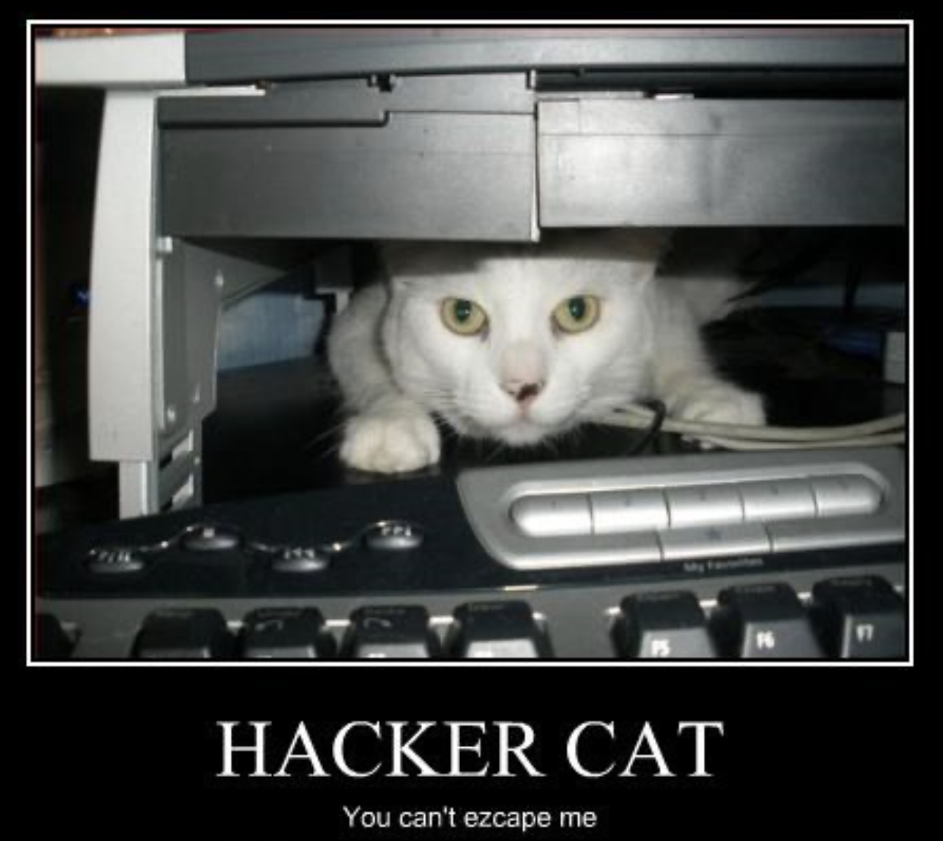
A unit about cats cybersecurity

Slide 3

3 Things
Understand the objectives and structure of this unit
01
Understand the technical requirements and role of the practical component
02
Understand the “rules” or ethics of cybersecurity and this unit
03

Slide 4
Pre-Requisites and Target Audience
There are over 500 students enrolled in the unit from diverse backgrounds
There will be no coding (unless you want to) in this unit and no assumption of prior knowledge in computer science or mathematics
This is an introductory course and so suitable for anyone wishing to familiarise themselves with the terms, concepts and practical aspects of Cybersecurity
The course is based on CyBOK - the Cybersecurity Book of Knowledge project (https://www.cybok.org/) and some elements of CISSP (Certified Information Systems Security Professional) from ISC²

Slide 5
Topics
Introduction to overall definitions and concepts of information security, the AIC triad, vulnerabilities, threats and risk
Cryptography: codes and ciphers
Computers and Networks
Threats
Vulnerabilities
Security management
Incidents
Forensics
Critical Infrastructure and Cyberphysical systems
Cyber Law
AI and Cybersecurity

Slide 6
Labs
The labs rely on using a technology called Docker
As this technology is *not* available on UWA lab machines, it must be run on your laptops
If you do not have a laptop that is capable of running the labs, you can arrange to borrow one: https://introlabs.cybermnemosyne.xyz
Else – invest in a decent laptop – it will make a big difference to your University life.
There is a contingency to run cloud-based sessions but it comes at a cost to us.
Labs start in Week 2
There will be a companion Capture The Flag server where you will need to provide flags that you find during the labs as evidence that you have completed them
Labs are worth 25% of assessment.

Slide 7
Other Assessment
Project released in Week 6 and ending in Week 10. This will be similar in format to the labs – except without the guidance part
Project is worth 25% of assessment
Final Exam: 50% of final assessment
Part multiple choice 40% of overall exam mark
Part short answers – closed book. 60% of overall exam mark.

Slide 8
Information Security
All human endeavour relies on information
Business, Government, Education, Research, Personal life
Information security is about protecting this information from “unauthorised access, harm or misuse”¹
This is done by preserving Confidentiality, Integrity and Availability of information

Slide 9
Cybersecurity
Cybersecurity is a subset of Information Security that concerns the digital realm – so:
Cyber security refers to the protection of information systems (hardware, software and associated infrastructure), the data on them, and the services they provide, from unauthorised access, harm or misuse. This includes harm caused intentionally by the operator of the system, or accidentally, as a result of failing to follow security procedures.¹
CIA is sometimes extended to include Authentication, Accountability, Non-Repudiation and Reliability

Slide 10
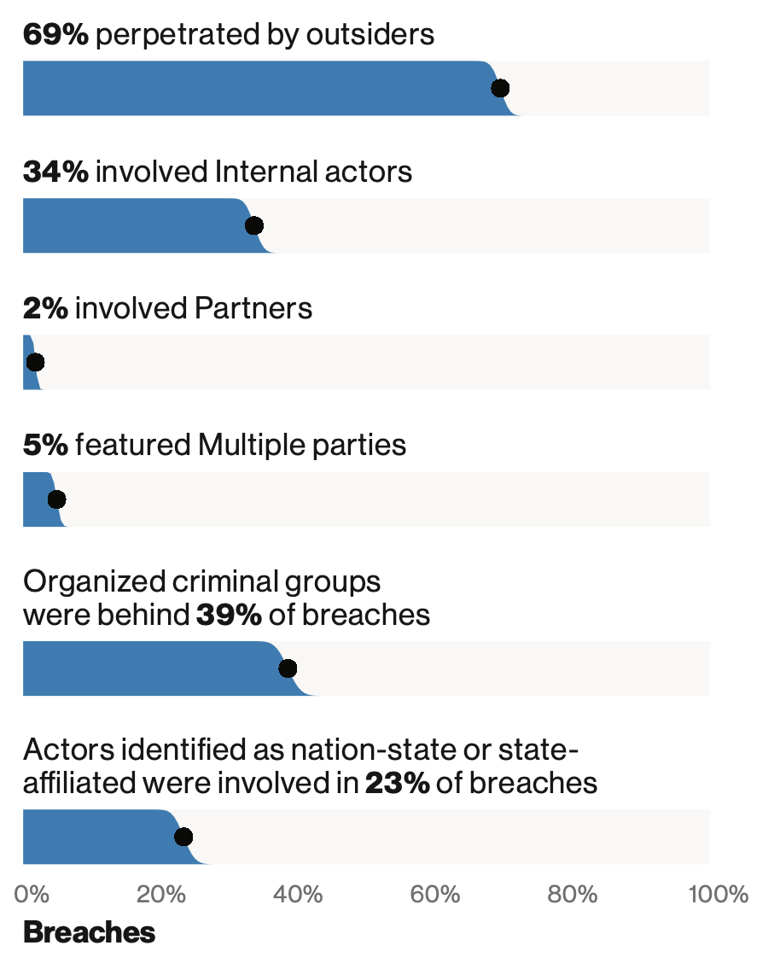
Human Threats
2018 breaches

Slide 11
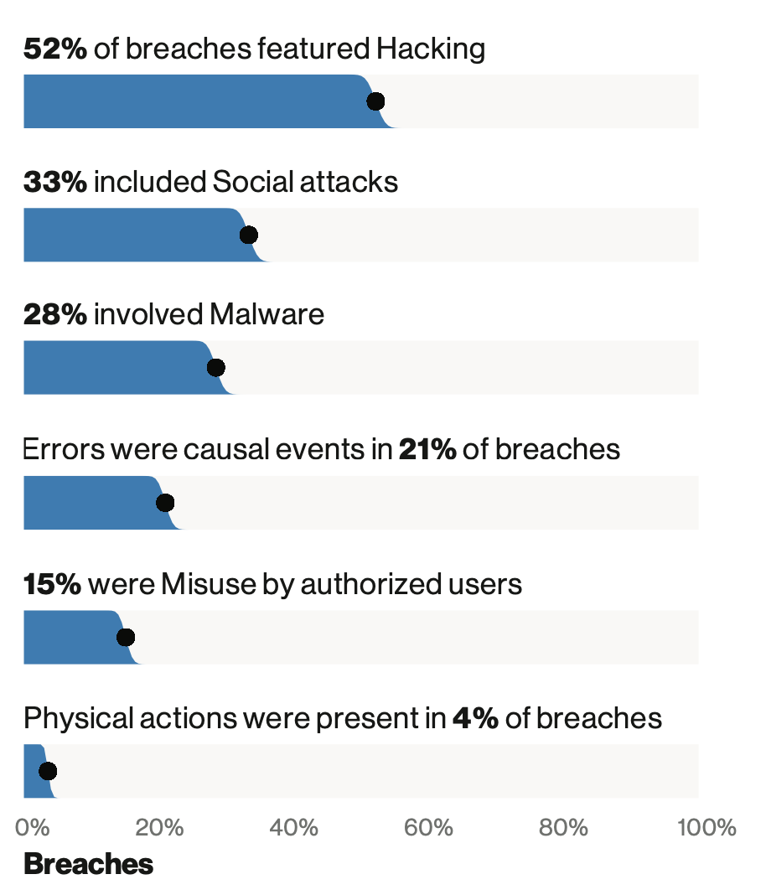
Human Exploits
2018 breaches

Slide 12
Learning Outcomes
To understand and be able to articulate
The language of Cybersecurity
The principles of preserving Confidentiality, Integrity and Availability
Principles of Risk Management
Cybersecurity in the domains of
* Human organisational and regulatory aspects, * Attacks and Defences, * System Security, * Software and Platform Security, * Infrastructure Security
Case studies will be used to illustrate and concretise language, terms and concepts throughout
Practical laboratory work will assist in practical aspects of Cybersecurity
An essay will allow for reflection on a topic in more depth

Slide 13
Ethics (or what you *absolutely* should not do)
Codes of Ethics are needed by all endeavours that are ”professions”. In cybersecurity, there are several organisations that have them
ISC²
Protect society, the common good, necessary public trust and confidence, and the infrastructure.
Act honourably, honestly, justly, responsibly, and legally.
Provide diligent and competent service to principals.
Advance and protect the profession.

Slide 14
Ethics continued…
Don’t do anything that you don’t have explicit authorisation to do
Being helpful and pointing out vulnerabilities to organisations is often problematic
Hacking without authorization is a crime in most countries
You can cause damage to yourself and others by being negligent
However that doesn’t stop you exploring, investigating and learning

